Slide 1
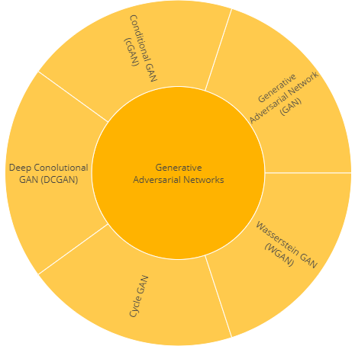
GANs (Generative Adversarial Networks)

Slide 2
Introduction
Generative Adversarial Networks (or GANs ) are one of the most popular Machine Learning algorithms developed in recent times. they belong to the set of algorithms named generative models. These algorithms belong to the field of unsupervised learning, a sub-set of ML which aims to study algorithms that learn the underlying structure of the given data, without specifying a target value.
Use Cases
Generating realistic artwork samples (video/image/audio).
Simulation and planning using time-series data.
Statistical inference.
generative models can also be used to generate inputs which may
expand small datasets.

Slide 3
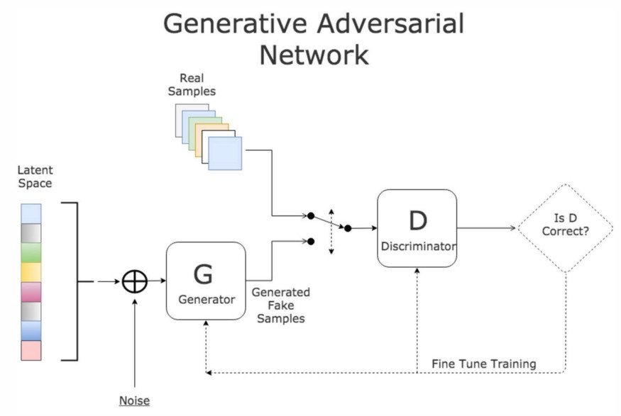

Slide 4
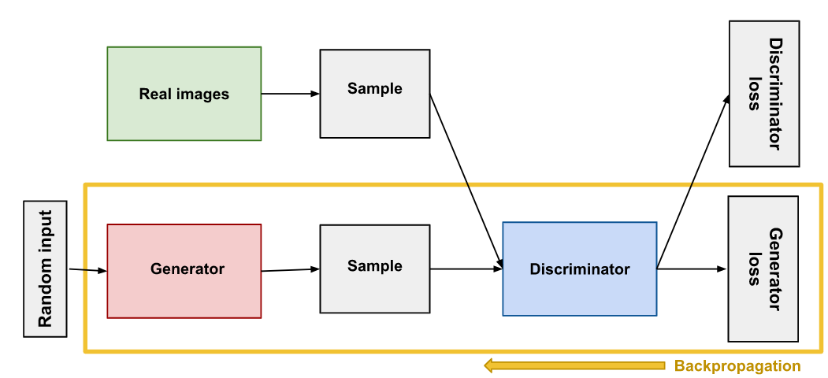

Slide 5
Generative Adversarial Networks are composed of two models:
The first model is called a Generator and it aims to generate new data similar to the expected one. The Generator could be assimilated to a human art forger, which creates fake works of art.
The second model is named the Discriminator. This model’s goal is to recognize if an input data is ‘real’ — belongs to the original dataset — or if it is ‘fake’ — generated by a forger. In this scenario, a Discriminator is analogous to an art expert, which tries to detect artworks as truthful or fraud.

Slide 6
Mathematically Modeling a GAN
A neural network G(z, θ₁) is used to model the Generator mentioned above. It’s role is mapping input noise variables z to the desired data space x (say images). Conversely, a second neural network D(x, θ₂) models the discriminator and outputs the probability that the data came from the real dataset, in the range (0,1). In both cases, θᵢ represents the weights or parameters that define each neural network.
As a result, the Discriminator is trained to correctly classify the input data as either real or fake. This means it’s weights are updated as to maximize the probability that any real data input x is classified as belonging to the real dataset, while minimizing the probability that any fake image is classified as belonging to the real dataset. In more technical terms, the loss/error function used maximizes the function D(x), and it also minimizes D(G(z)).

Slide 7

After several steps of training, if the Generator and Discriminator have enough capacity (if the networks can approximate the objective functions), they will reach a point at which both cannot improve anymore. At this point, the generator generates realistic synthetic data, and the discriminator is unable to differentiate between the two types of input.
Since during training both the Discriminator and Generator are trying to optimize opposite loss functions, they can be thought of two agents playing a minimax game with value function V(G,D). In this minimax game, the generator is trying to maximize it’s probability of having it’s outputs recognized as real, while the discriminator is trying to minimize this same value.

Slide 8
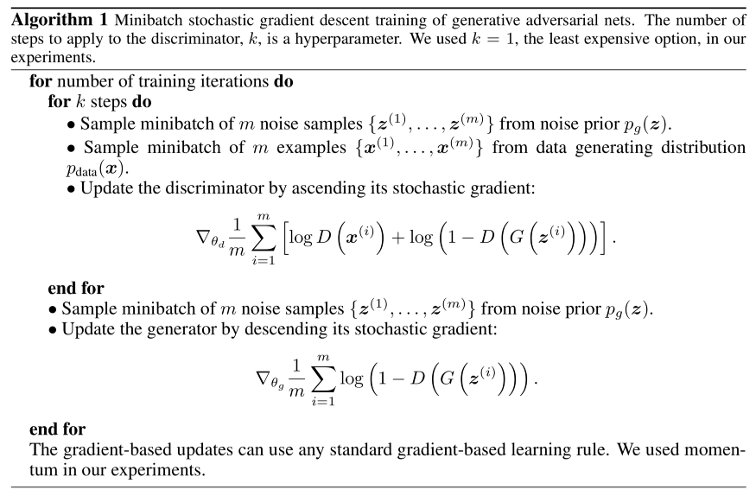
Training a GAN

Slide 9
The fundamental steps to train a GAN
Sample a noise set and a real-data set, each with size m.
Train the Discriminator on this data.
Sample a different noise subset with size m.
Train the Generator on this data.
Repeat from Step 1.

Slide 10
What is a DCGAN?
A DCGAN is a direct extension of the GAN described above, except that it explicitly uses convolutional and convolutional-transpose layers in the discriminator and generator, respectively.
The discriminator is made up of strided convolution layers, batch norm layers, and LeakyReLU activations. The input is a 3x64x64 input image and the output is a scalar probability that the input is from the real data distribution. The generator is comprised of convolutional-transpose layers, batch norm layers, and ReLU activations. The input is a latent vector, z, that is drawn from a standard normal distribution and the output is a 3x64x64 RGB image. The strided conv-transpose layers allow the latent vector to be transformed into a volume with the same shape as an image.

Slide 11
DCGAN architecture and its components
DCGAN utilises Convolutional and Transposed Convolutional layers, which it strategically embeds into a GAN architecture.
Convolutional Layers
Convolutions are a way to extract meaningful information from your data. They work particularly well with images allowing the network to learn the key features efficiently.
There are three parts to a convolution: Input (e.g., 2D image), a filter (a.k.a. kernel) and an output (a.k.a. convolved feature).
Transposed Convolutional Layers
Transposed Convolutions also use filters to process the data, but their goal is the opposite of a regular Convolution. I.e., we use them to up-sample the data to a larger output feature map, while regular Convolutions down-sample.

Slide 12
Convolution
A neural network can contain multiple Convolutional layers and additional Pooling layers to reduce the size of convolved features.
We will use Convolutional layers inside the Discriminator model and the final layer of the Generator model.

Slide 13
Transposed Convolutional Layers
We will only use the Transposed Convolutions inside the Generator model.

Slide 14
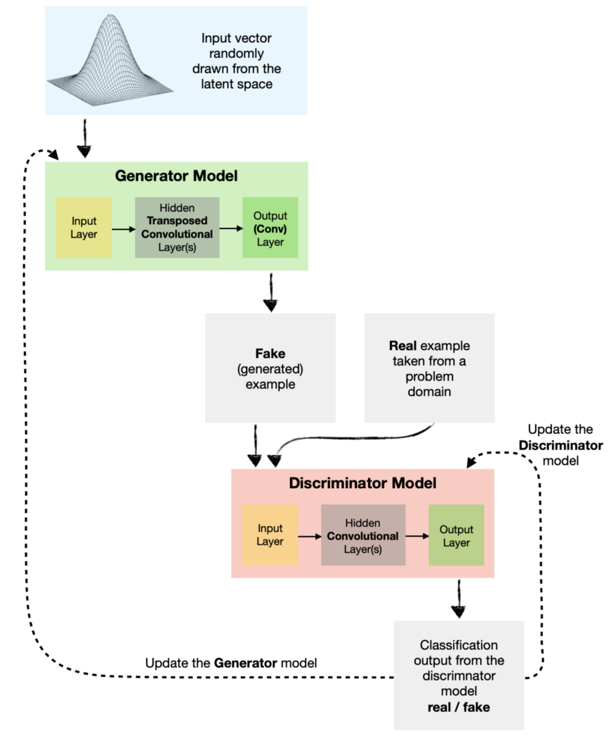
DCGAN architecture
A Generative Adversarial Network (GAN) combines the Generator and the Discriminator models that compete against each other in a zero-sum game, making them adversaries.
The Generator creates fake images attempting to fool the Discriminator into believing they are real. Meanwhile, the Discriminator learns the essential features of the pictures in order to differentiate between real and fake examples.

Slide 15
References-
https://jonathan-hui.medium.com/gan-whats-generative-adversarial-networks-and-its-application-f39ed278ef09
https://www.analyticsvidhya.com/blog/2021/07/deep-convolutional-generative-adversarial-network-dcgan-for-beginners/
https://jonathan-hui.medium.com/gan-dcgan-deep-convolutional-generative-adversarial-networks-df855c438f
https://medium.com/ai-society/gans-from-scratch-1-a-deep-introduction-with-code-in-pytorch-and-tensorflow-cb03cdcdba0f
https://pytorch.org/tutorials/beginner/dcgan_faces_tutorial.html
https://www.tensorflow.org/tutorials/generative/dcgan
https://towardsdatascience.com/deep-convolutional-gan-how-to-use-a-dcgan-to-generate-images-in-python-b08afd4d124e

